Slide 1

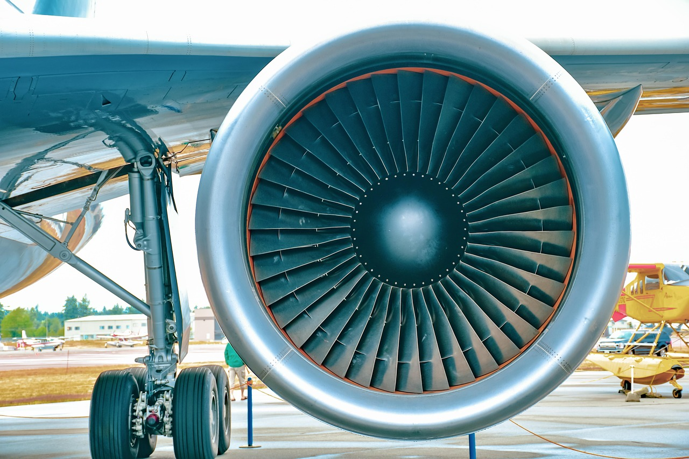
Capstone Project
AeroMind
AI-Powered Smart Aircraft
Predictive Maintenance
and Voice Assistant System
Submitted by
Archana M P
Hema V
Rimi Sivakumar
Priya Raj P R
Noufiya J N
Artificial Intelligence Programming Assistant · 2025–2026

Slide 2
Introduction
What is AeroMind?
Key Highlights
AeroMind is a machine learning based predictive maintenance system built for aircraft turbofan engines.
✈ Dataset:
NASA CMAPSS
It analyzes real-time sensor data to predict the Remaining Useful Life (RUL) of engines.
⚙ Algorithm:
XGBoost
📊 Accuracy:
R² = 0.968
The system enables airlines to schedule maintenance before engine failure — preventing accidents and reducing costs.
📉 Error:
MAE = 8.9 cycles
It is deployed as an interactive Streamlit web dashboard with voice assistant capabilities.
🤖 Models:
5 ML + 1 LSTM
🎙 Feature:
Voice Assistant
💻 Platform:
Streamlit Dashboard

Slide 3
Problem Statement
Aircraft engine failures are a critical challenge in the aviation industry.
Reactive Maintenance
Scheduled Maintenance
High Financial Loss
Fixing engines only after failure leads to accidents, flight cancellations and emergency costs.
Servicing at fixed intervals wastes resources — healthy engines get unnecessarily grounded.
Unplanned downtime costs $10,000 to $150,000 per hour for airlines globally.
Our Solution:
Use machine learning to predict engine failure BEFORE it occurs. By analyzing sensor data continuously, AeroMind gives maintenance teams advance warning — saving lives and reducing costs by up to 40%.

Slide 4
Dataset & Methodology
NASA CMAPSS Dataset
ML Pipeline
Source:
NASA Ames Research Center
1
Load Data —
Read NASA CMAPSS space-separated file
File:
train_FD001.txt
2
Feature Engineering —
Create RUL column, name all columns
Engines:
100 turbofan engines
3
Data Cleaning —
Drop 6 zero-variance sensor columns
Total Rows:
20,631 sensor readings
4
Train/Val Split —
80% training, 20% validation (random_state=42)
Raw Sensors:
21 sensors + 3 op. settings
Normalization —
MinMaxScaler fit on train, transform both
5
After Cleaning:
15 sensors (6 dropped)
Model Training —
Train 5 ML models + LSTM comparison
6
Target:
RUL = max_cycle − current_cycle
7
Evaluation —
Compare MAE, RMSE, R² across models
Split:
80% train / 20% validation
8
Deployment —
XGBoost deployed in Streamlit dashboard
Scaling:
MinMaxScaler → 0 to 1 range

Slide 5
Model Comparison
Model
MAE
RMSE
R² Score
Result
Linear Regression
30.4
39.2
0.663
❌ Weak
Decision Tree
13.2
24.4
0.870
⚠ Average
Random Forest
11.0
16.2
0.943
✓ Good
Gradient Boosting
17.7
23.8
0.876
⚠ Average
XGBoost
8.9
12.0
0.968
✅ Best
LSTM (Deep)
60.6
—
-0.27
❌ Failed
Note: LSTM failed because it requires sequential time-series input, but our data was shuffled tabular format. XGBoost handles this perfectly.

Slide 6
Why XGBoost is the Best Model
R² Score
Gradient Boosting
Built-in Regularization
Each tree corrects errors of the previous one — iteratively improves.
L1 and L2 regularization prevents overfitting automatically.
0.968
MAE
Handles Tabular Data
Fast & Parallel
8.9 cycles
Excels on row-level sensor data without needing sequential ordering.
Parallel tree building — trains quickly even on large datasets.
RMSE
12.0 cycles
Feature Importance
Handles Noise
96.8% Accuracy
Automatically ranks which sensors matter most for prediction.
Robust to sensor noise and outliers common in aviation data.

Slide 7
Streamlit Dashboard — 4 Modules
01
📊
02
🤖
03
✈
04
💬
Dashboard
Model Arena
RUL Predict
AI Chatbot
RUL Distribution Histogram
Train 5 ML Models
Manual Sensor Input Form
20+ Topic Q&A
Sensor Degradation Chart
Bar + Radar Charts
Live XGBoost Prediction
Engine Status by ID
Feature Correlation Heatmap
Actual vs Predicted (3 graphs)
Health Gauge + Status Badge
Voice Recognition (Speech AI)

Slide 8
RUL Prediction & Engine Health Status
Enter
Sensor
Values
MinMax
Scaler
Normalize
XGBoost
Predict
RUL
Result
Health
Status
▶
▶
▶
▶
✅
⚠️
🚨
HEALTHY
SCHEDULE MAINTENANCE
IMMEDIATE INSPECTION
RUL > 100 cycles
RUL 30–100 cycles
RUL < 30 cycles
Continue normal operations
Plan maintenance service soon
Stop and inspect immediately
Formula: RUL = max_cycle − current_cycle

Slide 9
AI Chatbot & Voice Assistant
Voice Flow: 🎤 "engine five" → sounddevice records audio → Google Speech API → "engine 5" → XGBoost predicts → ✅ Status shown
🤖 ML Concepts
📊 Metrics
✈ Fleet
💡 Guidance
Explain XGBoost
What is MAE?
Engine 5 status?
How to predict?
What is RUL?
What is RMSE?
Critical engines?
Why pred maint?
XGBoost vs LSTM
Model accuracy?
Fleet health
Hyperparameters?
Overfitting?
R² score?
Maint schedule
Upload format?

Slide 10
Results & Impact
96.8%
8.9
70%
40%
R² Score
(XGBoost)
MAE
(cycles)
Failure
Reduction
Cost
Savings
Technologies Used
Python 3
XGBoost
Streamlit
Scikit-learn
TensorFlow
Pandas / NumPy
Speech API
Matplotlib
Joblib
AeroMind successfully predicts aircraft engine Remaining Useful Life with 96.8% accuracy using XGBoost. The system provides airlines with an intelligent, real-time health monitoring platform that prevents failures, reduces maintenance costs by 40%, and improves passenger safety — all through an easy-to-use Streamlit dashboard.

Slide 11
Project Summary
Title:
AI-Powered Aircraft Predictive Maintenance
and Voice Assistant System
Dataset:
NASA CMAPSS — 100 engines, 20,631 rows
Thank You
Best Model:
XGBoost — R² = 0.968, MAE = 8.9 cycles
Platform:
Streamlit Dashboard — 4 interactive modules
Open for Questions
Feature:
Voice Assistant + AI Chatbot (20+ topics)
Impact:
70% failure reduction, 40% cost savings
Artificial Intelligence Programming Assistant · 2025–2026

